Slide 1
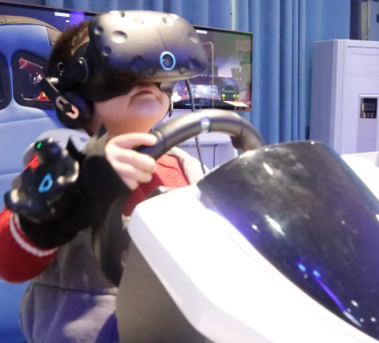

AUTOMATED VR CAR FOR KIDS
Team Name : ToGo
Team Leader : Sameeha M
Team members 1: Divya Muthusamy
Team member 2 : Mary Sneha Betty V

Slide 2
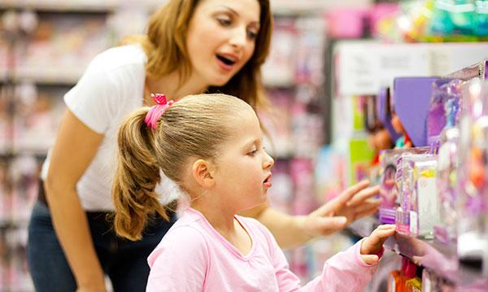

WHAT ARE WE TRYING TO ACHIEVE?
We all love to shop at peace, and at our own pace, when especially in
stores like Walmart which have huge variety of options to choose from.
You’ll need time and space to have a wonderful shopping journey.
But, Have you ever witnessed how much it takes for a parent to control their kids at stores ?
Because it is sometimes commendable to see parents in shopping malls tackling their kids at the best.
There are so many problems faced while shopping with kids.
Our project aims to ease the shopping life of parents by being a solution to those problems of parents while shopping with their kids

Slide 3
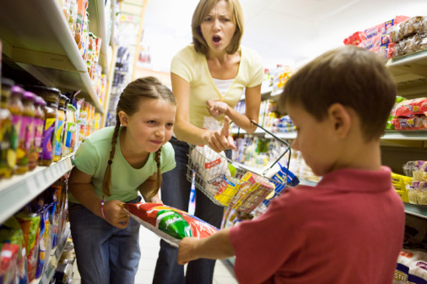
TOGO CAN SOLVE PROBLEMS LIKE:
01
02
03
04
05
INJURIES
MISSING KIDS
EMBARRASSING MOMENTS
UNWANTED NOISE
PROPERTY DAMAGE
Parents have to face embarrassing moments in stores while their kid throws a tantrum. This can possibly make parents double think about coming for in-store shopping
When children throw a tantrum and make noise. they not only affect the parents but also fellow shoppers who wish to shop at peace.
Hyperactive, uncontrollable children can cause property damage if not properly attended by the parent at all times.
24,000 children are injured in shopping carts every year, an average of 66 per day. Over 70% of injuries result from kids falling from the shopping cart.
Some parents are losing their children in shopping marts as kids tend to wander away .

Slide 4

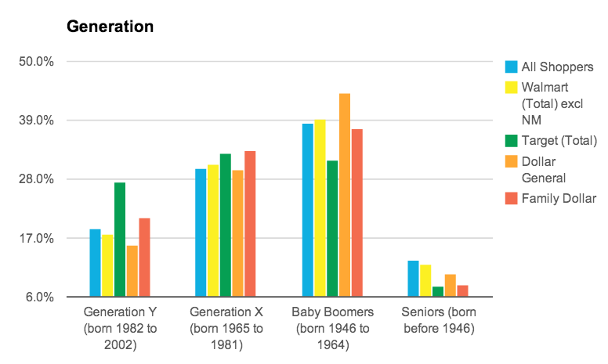
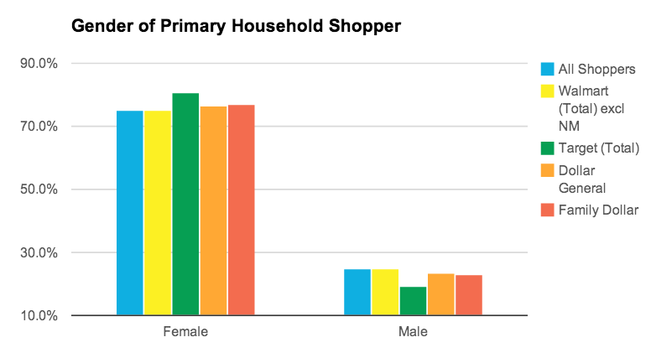
HOW DOES TOGO HELP WALMART ?
From the graph we can derive that the maximum number of Walmart customers are Females, but in the category of Baby Boomers. The Gen X and Y category of customers is comparatively lower than our competitors which our are prime targets.
So, we believe Togo can
Create a Wonderful shopping experience for Kids and Parents, which in-turn increases the numbers of customers in our prime target category to shop at Walmart.
The attractive features of Togo will excite customers to visit Walmart frequently.
This in-turn increases the Sales at Walmart.

Slide 5

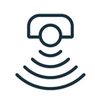

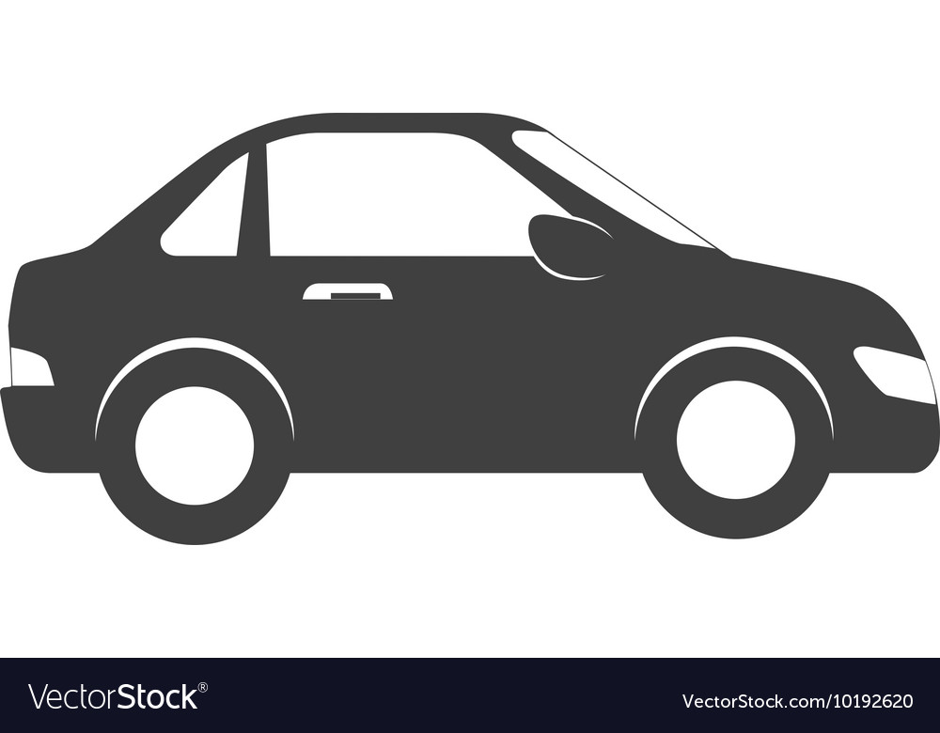
OUR SOLUTION- HOW IT WORKS?
TOY CAR
VR HEADSET
WRIST BAND WITH SENSOR
The Toy car contains RFID Reader and NodeMcu to read transmitted values for automatic motion of the car according to movement of wristband
The Vr Headset will contain a Virtual reality experience made in Unity that the children can enjoy and will keep them hooked to their seats.
Rc522 RFID Module , Imu Sensor and NodeMcu be integrated with wristband to track the movement of the parent.

Slide 6
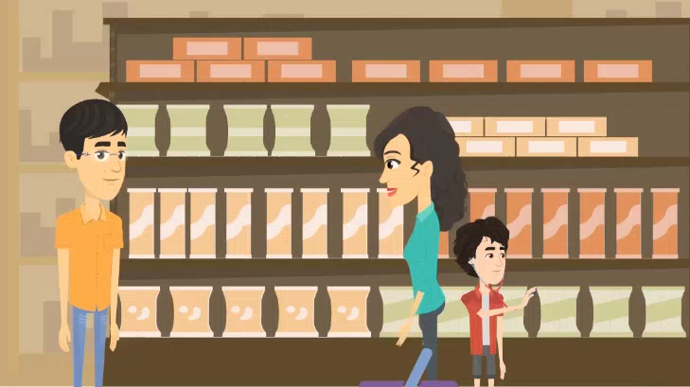

Slide 7
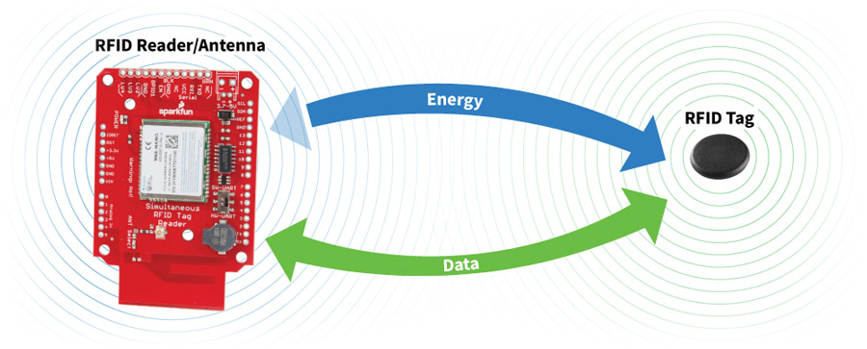
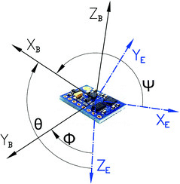
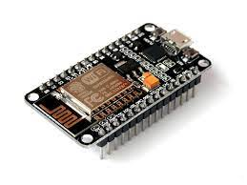


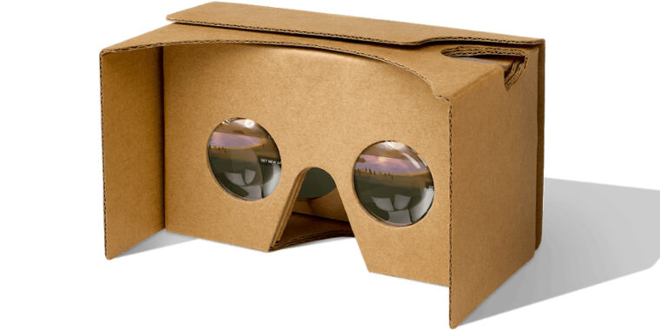
HARDWARE COMPONENTS
VIRTUAL REALITY COMPONENTS
IMU SENSOR
NODEMCU
GOOGLE CARDBOARD

Slide 8
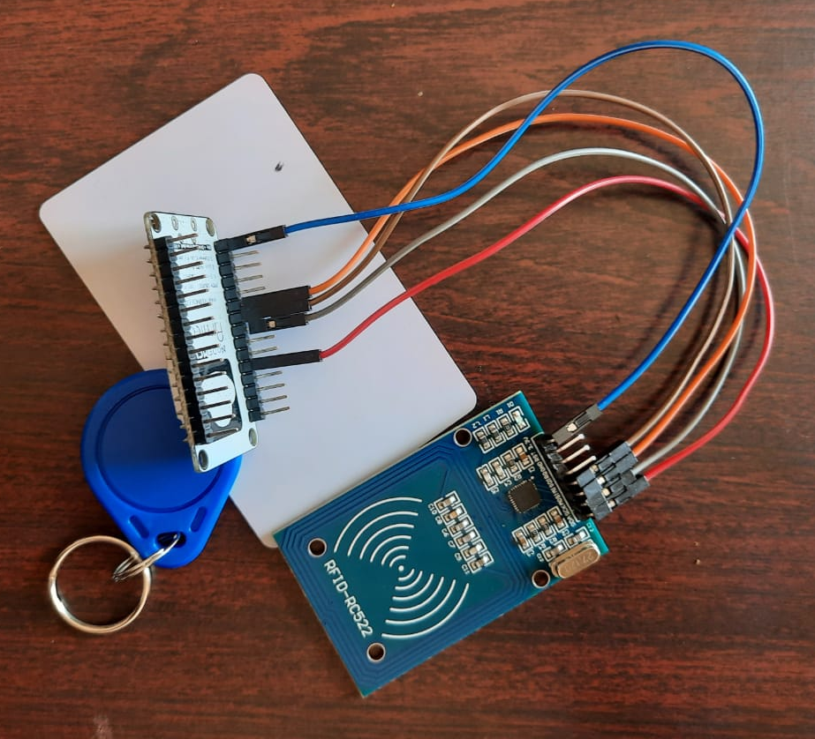
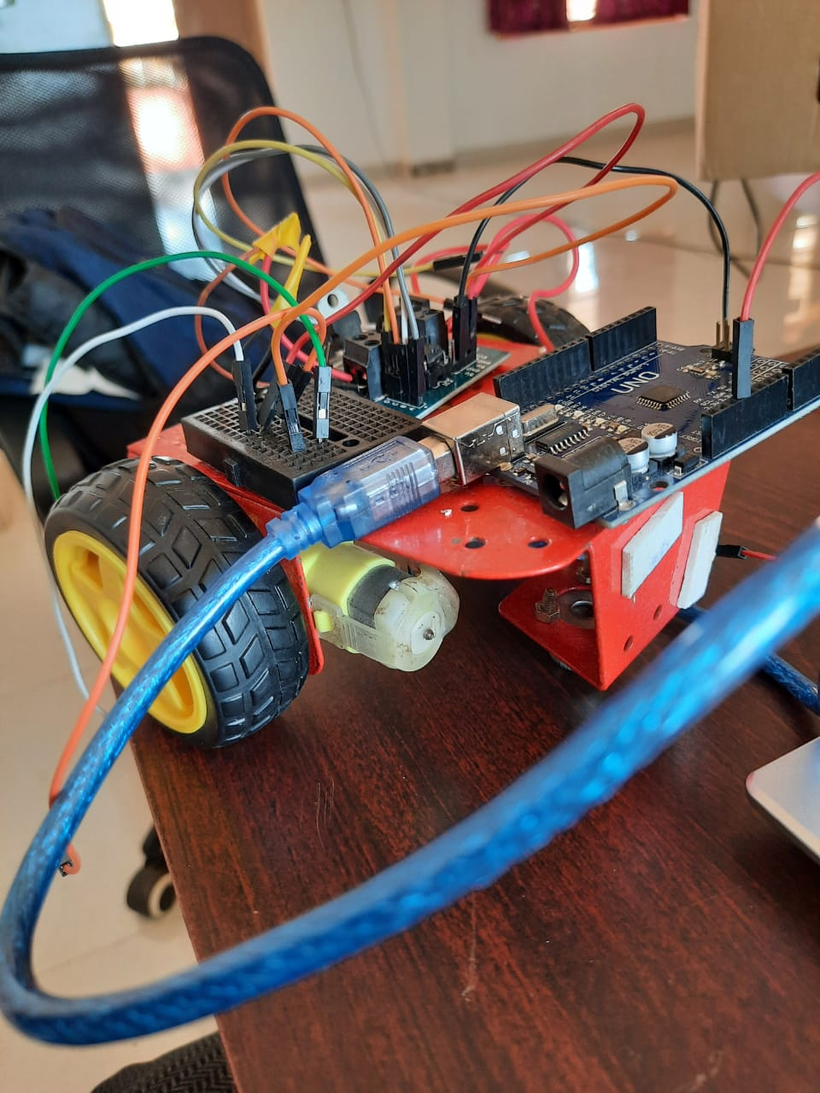
COMPONENTS USED BY US FOR PROTOTYPE
We have used the RFID Tag and Reader and the imu sensor to locate the parent the signals are transmitted and received by the NodeMcU so the wheels of our car can move automatically move with our parent
Rc522 RFID TAG
RFID READER

Slide 9
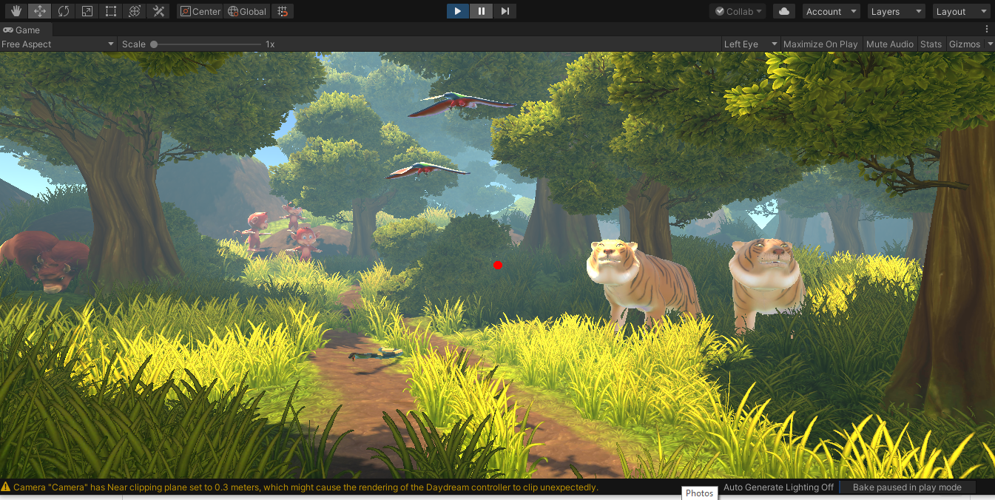
VR DEMO SCENE
We decided to take the kids into a virtual tour through the forest. Our scene contains different animals with sound effects. Kids can move around the scene and meet animals and also learn about them as the animals introduce themselves

Slide 10
UNIQUE SELLING POINTS
The use of VR Tech will always excite the children to come to Walmart and improve Sales
Google cardboard is cheaper compared to other gears and only requires a mobile phone with the vr application in it.
Innovative approach to kinder the shoppings need of parents and kids at the same time.
Will make Walmart a company that not only cares about customer needs but also who cares about the experience of shopping by making it unique.

Slide 11
FUTURE ROADMAP
Venus has a nice name
DAY 3
CAN BE ALSO IMPLEMENTED IN SHOPPING CART SO EVEN TROLLEYS DON’T HAVE TO BE PUSHED
WILL REQUIRE TROLLEYS THAT CAN HANDLE MORE WEIGHT.
THIS WILL ENSURE CHILDREN DON’T GET BORED OF THE VR APPLICATION
MORE VR APPLICATIONS CAN BE INTEGRATED SO CHILDREN CAN VIEW DIFFERENT APPS WHENEVER THEY VISIT
Mars is a cold place

Slide 12
THANK YOU!
Team Name : ToGo
Team Leader : Sameeha M
Team members1: Divya Muthusamy
Team member 2 : Mary Sneha Betty V

